Slide 1
Habitable Planets
By Aaron Lawson, Tom Rushman and Sam Sheavyn-Bentley, aka Team JJ Wattage

Slide 2
Contents
Brief Introduction to Life
Habitable Conditions
Habitable Zone Calculations
Potentially Habitable Exoplanets
Exoplanet Detection
Bibliography
Slide 3
Slide 5
Slide 9
Slide 13
Slide 20
Slide 25

Slide 3
What Is Life?
“Life is a dream for the wise, a game for the fool, a comedy for the rich, a tragedy for the poor.”
-Shalom Aleichem
The condition that distinguishes animals and plants from inorganic matter, including the capacity for growth, reproduction, functional activity, and continual change preceding death.
The existence of an individual human being or animal.
The period between the birth and death of a living thing.
Vitality, vigour, or energy.
“Life isn't about finding yourself. Life is about creating yourself.”
-George Bernard Shaw

Slide 4
What is Needed?
Atmosphere
The atmosphere must contain the right amounts of gases, such as oxygen. to sustain life.
It also has to be thick enough to stop rays of radiation (from the Sun) entering the atmosphere, such as what has happened to Mars.
Climate
Earth has a suitable climate to sustain life on its surface, this is helped by the moderate amount of carbon dioxide in its atmosphere.
It does not go from extreme to extreme, such as Mercury does.
Water
This is believed to be the most important chemical that is necessary for life.
Many other liquids contain poisonous components or are acidic/alkaline.
Water can be found everywhere and in every state on Earth.
Light
All planets receive light from the Sun, no other planet uses it as well as Earth however.
Plants need the light to grow, and they produce and put oxygen into the atmosphere.
It is believed if we could get plants to grow on planets such as Mars, this would increase the habitability of planets like this.

Slide 5
Some Source of Energy
The Sun is our source of energy as all life on earth is dependant on it but in other areas it could be from a different source and so it is hard to predict where they would be because if the energy comes mainly from the core then it would be outside the h
abitable zone
The most important thing is to enjoy your life - to be happy - it's all that matters.
Audrey Hepburn
Read more at http://www.brainyquote.com/quotes/topics/topic_life.html#bOe8J5R8gGydfBy6.99

Slide 6
An atmosphere
For humans it must contain a good amount of oxygen but for plants CO2 is important, and for this reason most low mass planets are likely to be inhabitable as they suffer from issues with atmosphere retention but even if it is a high mass planet it could struggle to retain atmosphere due to high temperatures.
Life's most persistent and urgent question is, 'What are you doing for others?'
Martin Luther King, Jr.
Read more at http://www.brainyquote.com/quotes/topics/topic_life.html#bOe8J5R8gGydfBy6.99

Slide 7
Basic elements
The required elements for life are Carbon, Hydrogen, Nitrogen, and Oxygen, and 96% of the earth's biomass is made up of these four elements, but this quantity is not necessary, since as long as they make up the majority of the biomass then it is possible for humans to live there.
Life is a dream for the wise,
a game for the fool,
a comedy for the rich,
a tragedy for the poor.
Sholom Aleichem

Slide 8
The Habitable zone
This means they have to be a comfortable distance from the star that they orbit so there isn’t heavy heat radiation but not too cold. Earth is right in the middle of this zone and Mars is just on the outside edge of the zone.
You calculate the habitable zone as follows:

Slide 9
Stage 1
Step 1
Calculate the absolute visual magnitude of the host star based on the star’s apparent magnitude.
M_{v}=m_{v} – 5 log(d/10)
where:
M_{v} = Absolute magnitude of the star
m_{v} = Apparent magnitude of star (Visual spectrum)
d= distance of planet from the star (parsecs)

Slide 10
Stage 1
Step 2
Calculate bolometric magnitude of the host star.
M_{bol} = M_{v} + BC
Where:
M_{bol}= Bolometric magnitude
M_{v}= Absolute magnitude of the star (this links to stage 1)
BC= Bolometric correction constant

Slide 11
Stage 1
step 3
calculate the absolute luminosity of the star
L_{star}= 10((M_{bol star}-M_{bol sun})÷-2.5)
Where
L_{star}=the absolute luminosity of the star
M_{bol star}=the bolometric magnitude of the star
M_{bol sun}=the bolometric magnitude of our sun = 4.72
2.5 is called “Pogson’s Ratio” and is a constant for comparing stellar luminosities

Slide 12
Stage 2
The Final step : The approximate radii of the boundaries of the habitable zone.
R_{i}=√(L_{star}÷1.1)
R_{o}=√(L_{star}÷0.53)
where
R_{i} =the inner boundary of the habitable zone in Astronomical units (AU)
R_{o} =the outer boundary of the habitable zone in astronomical units (AU)
1.1= a constant representing stellar flux at the inner radius
0.53= a constant representing stellar flux at the outer radius

Slide 13
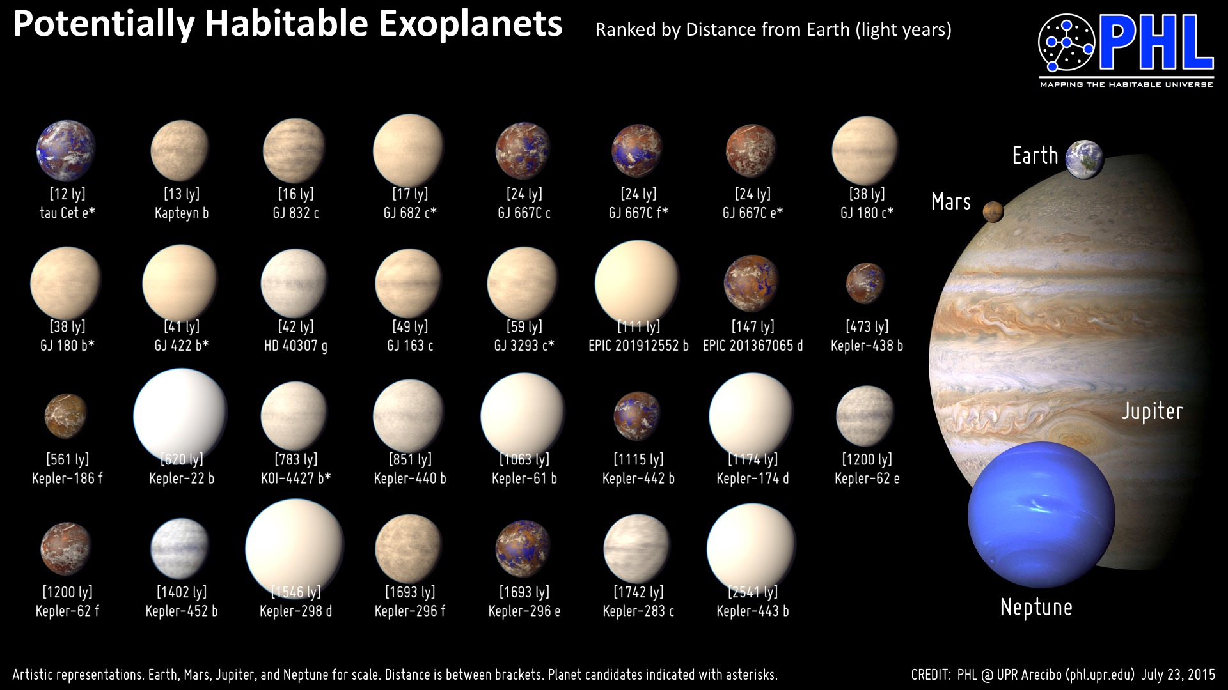

Slide 14
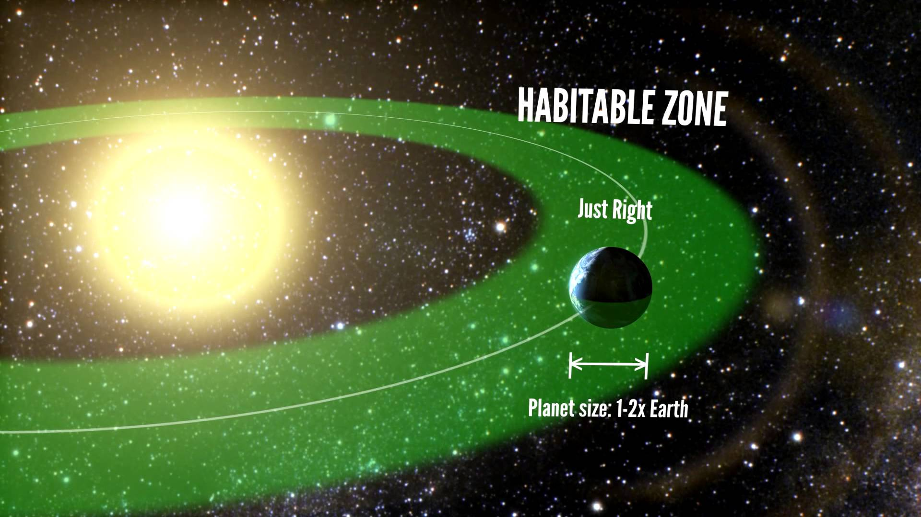
Astronomers have discovered a few planets in the ‘Goldilocks zone’ (the distance away from a star that allows planets with sufficient atmospheric pressure to maintain liquid surface water) and rated them on several factors that affect their habitability, including Earth Similarity* and Standard Primary Habitability (suitability for vegetation dependant on surface temperature and relative humidity). The following planets are a few of the closest and most likely habitable exoplanets.
*Earth Similarity is based on: radius, density, escape velocity and surface temperature; for example, Venus is 0.444 and Mars is 0.697.

Slide 15
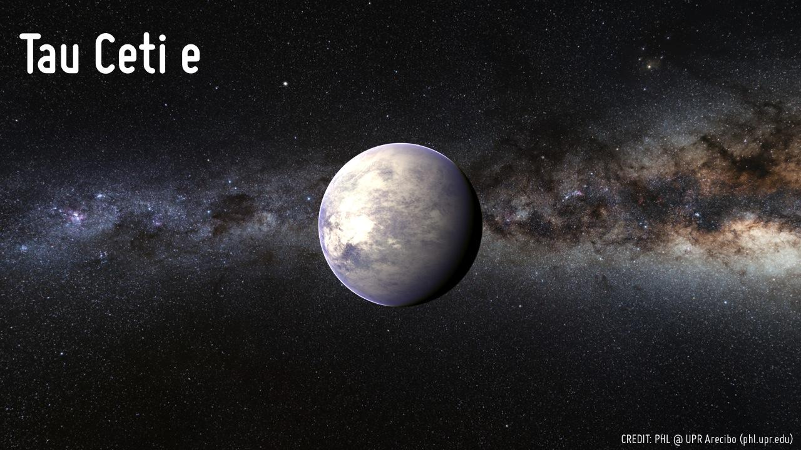
Tau Ceti e
Tau Ceti e is an unconfirmed planet 11.9 light years away that orbits the Tau Ceti star in its habitable zone. Few characteristics of it are known other than its orbit and mass, and it has an orbit of 168 days and is 4.3x Earth’s mass as a minimum. This is under 5 Earth masses, so it is considered Earth size. It has an Earth Similarity Index of 0.78 (out of 1) and if it has an Earth-like atmosphere, its surface temperature would be around 68 °C.

Slide 16
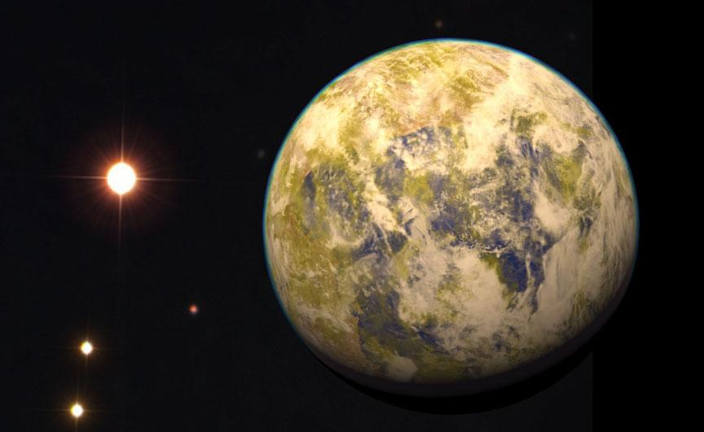
Gliese 832 c
Gliese 832 c is a planet 16.1 light years away that orbits the Gliese 832 star in its habitable zone. The planet is approximately 5.4 Earth masses, making it super-Earth size with an orbital period of 36 days. The planet's average equilibrium temperature is predicted to be 253 Kelvins (−20 °C), but is estimated to vary from 233 Kelvins (−40 °C) at aphelion to 280 Kelvins (7 °C) at perihelion. Its large mass, however, means it may have a much denser atmosphere which would make it much hotter and more similar to Venus, meaning it would be much less likely to sustain life. It is considered “the nearest best habitable world candidate so far” by the planet’s discoverers.

Slide 17
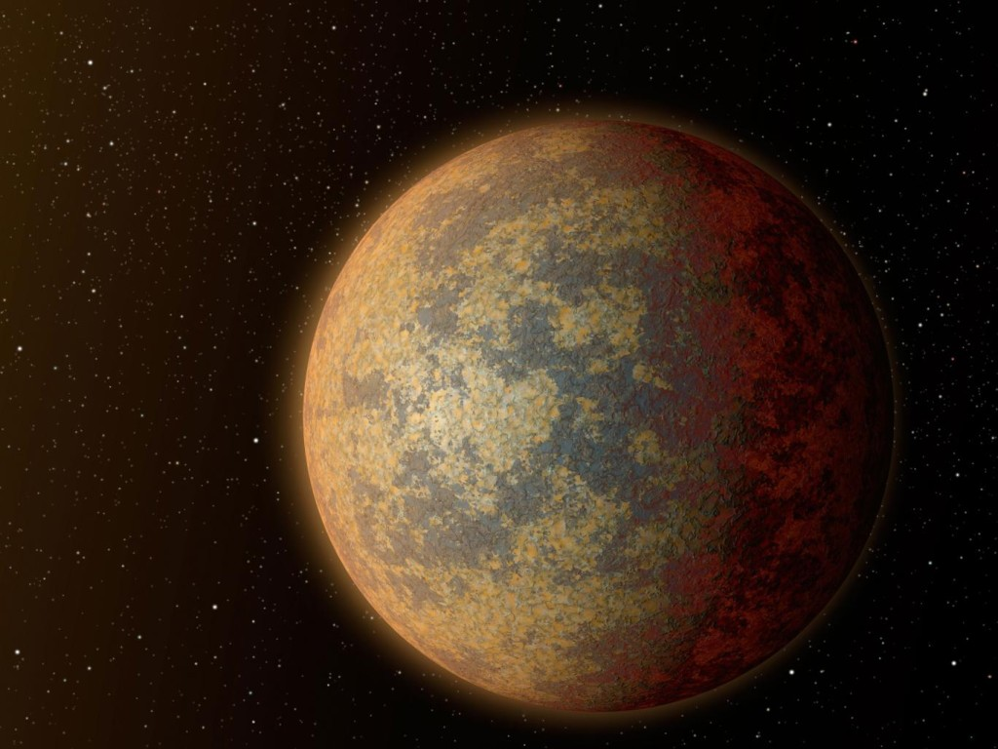
Wolf 1061 c
Wolf 1061 c is a planet 13.8 light years away that orbits the Wolf 1061 star in its habitable zone. The planet is approximately 4.3 Earth masses with an orbital period of 17.9 days. It is thought to be a rocky planet with a surface gravity of 1.6 times Earth’s. It was discovered very recently on 17 December 2015. The planet is likely to be tidally locked, meaning one side permanently faces the star and the other side permanently faces away, leaving it in an ‘eternal night’. This would mean that the dark side may have temperatures that could sustain liquid water, and if the atmosphere is thick enough, the light side may be able to facilitate heat transfer away from the planet, making it even more habitable.

Slide 18
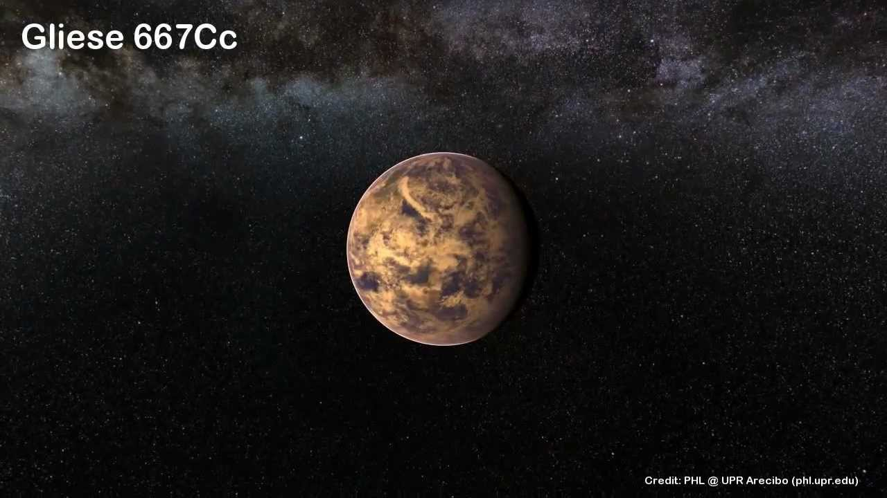
Gliese 667 Cc
Gliese 667 Cc is a planet 23.6 light years away that orbits the Gliese 667 C star in its habitable zone. The planet is approximately 3.8 Earth masses with a year lasting 28.2 days. It would receive approximately 90% of the light that Earth does, but most of that would be infrared, and the planet would only receive approximately 20% of the amount of visible light that Earth does. Gliese 667 Cc is one of the most similar planets to Earth known, with an Earth Similarity Index of 0.85, and has a very similar temperature to Earth.

Slide 19
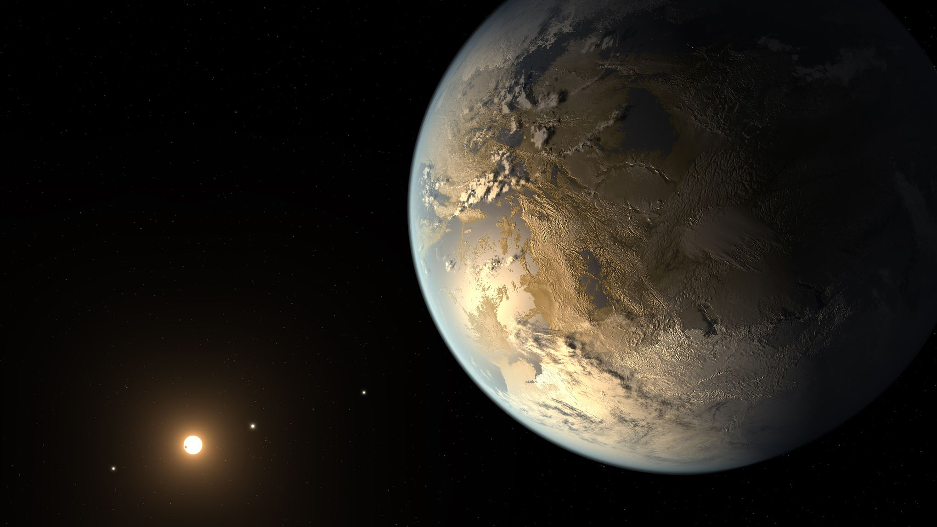
Kepler-438 b
Kepler-438 b is a planet 470 light years away that orbits the Kepler-438 star in its habitable zone. The planet has a radius 1.12 times Earth’s with a year lasting 35.2 days, and was discovered on 6 January 2015. It is one of the most Earth-like planets (in terms of size and temperature) discovered, with an Earth Similarity Index of 0.88. However, it has been discovered that the planet is subjected to superflare activity every 100 days, much more powerful than the stellar flares emitted by the Sun, and these would be capable of sterilising life on Earth.

Slide 20
Methods of Detecting Exoplanets

Slide 21
Direct Imaging
This method involves simply searching for planets with coronagraphs. It is hard to estimate an accurate mass for these planets because it is based off of the age of star and temperature of the planet. Planets are small and dim, unlike stars, so planets are often lost in the glare of bright stars, and therefore direct imaging is often very difficult or even impossible.

Slide 22
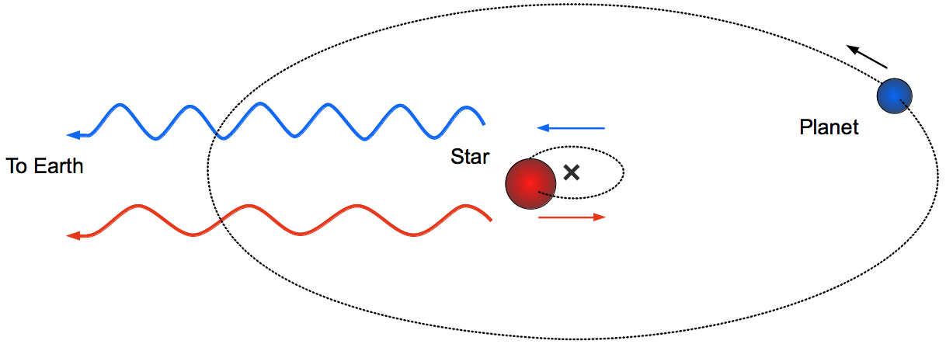
Radial Velocity
This is the most effective method of detecting exoplanets with modern day technology. Stars that have an orbiting body move in a slight orbit, and if a star is moving towards the observer, its spectrum is shifted towards the blue, and if a star is moving away from the observer, it is shifted towards the red. This kind of movement indicates the presence of an orbiting body, and can be used to give an estimate of its minimum mass.

Slide 23
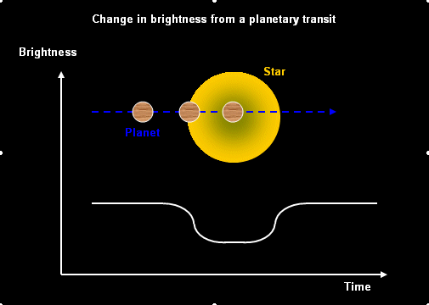
Transit Photometry
This method involves measuring the dimming of a star as an orbiting planet passes between it and Earth. If this dimming is regular, it is likely that a planet is orbiting this star. This method is useful for determining the size, but not mass, of a planet, as a large planet orbiting a small star will be cause more dimming than a small planet orbiting a large star.

Slide 24
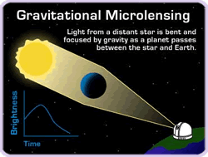
Gravitational Microlensing
This method is the best at detecting exoplanets at a great distance from Earth. When light travels from one star past another star, the light is bent slightly, making those stars seem slightly further away to an observer. If a star has a small orbiting body, then bends the light stream as well and creates a third image of the star, which to observers on Earth is seen as a temporary spike in the brightness of the star, and this indicates the presence of a planet.

Slide 25
Bibliography
http://phl.upr.edu/projects/habitable-exoplanets-catalog
https://en.m.wikipedia.org/wiki/Gliese_667_Cc
https://en.m.wikipedia.org/wiki/Tau_Ceti_e
https://en.m.wikipedia.org/wiki/Wolf_1061c
https://en.m.wikipedia.org/wiki/Gliese_832_c
https://en.m.wikipedia.org/wiki/Kepler-438b
http://www.bobthealien.co.uk/earthlife.htm
http://marshall.org/space-policy/
https://upload.wikimedia.org/wikipedia/commons/0/09/Artist's_impression_of_supernova_1993J.jpg
http://weknowyourdreams.com/image.php?pic=/images/life/life-01.jpg
https://c1.staticflickr.com/1/83/243471664_bbf73bf4c6_z.jpg?zz=1
http://c.fastcompany.net/multisite_files/fastcompany/imagecache/1280/poster/2014/10/3037096-poster-p-1-9-different-definitions-on-the-meaning-of-work-life-balance.jpg
https://en.m.wikipedia.org/wiki/Methods_of_detecting_exoplanets
http://www.planetary.org/explore/space-topics/exoplanets/direct-imaging.html
http://www.planetary.org/explore/space-topics/exoplanets/radial-velocity.html
http://www.planetary.org/explore/space-topics/exoplanets/transit-photometry.html
http://www.planetary.org/explore/space-topics/exoplanets/microlensing.html
http://www.planetarybiology.com/calculating_habitable_zone.html

